Slide 1

Platform, APIs & Apps:
Building the Where Ecosystem
Gary Gale, Director, Places
Nokia Location & Commerce
gary.gale@nokia.com @vicchi

Slide 2


I’m Gary; a Geo-Technologist and a Geographer at heart
Director, Places, Nokia Location & Commerce
http://www.vicchi.org - http://www.garygale.com - @vicchi
Ken Yeung / Flickr : http://www.flickr.com/photos/kyeung808/4820451850/
Notes:
Good afternoon everyone. I'm Gary. I'm a geo-technologist by profession and a geographer at heart. I’m the Director of Places for Nokia’s Location and Commerce group.

Slide 3
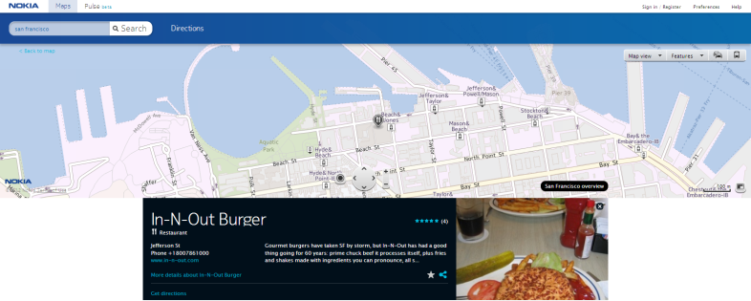
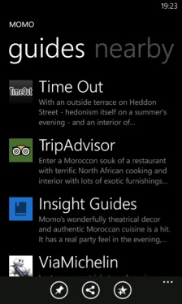
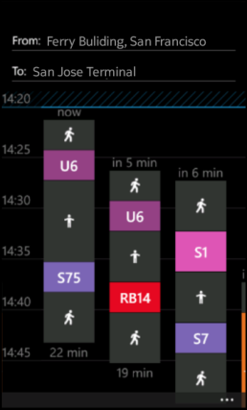

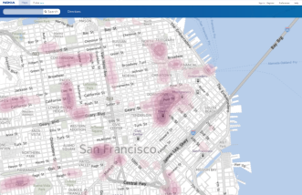
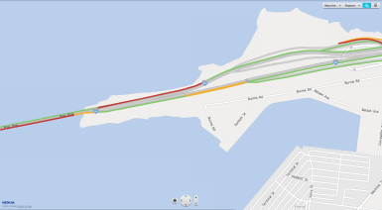








The Where Ecosystem @ Where 2012
Where is a good
place for lunch?
Where can I get a deal on my favorite coffee?
Can I make the next
train to San Jose?
Where’s the best
place to go tonight?
Where are traffic delays on my route?
Where should I go to shop?
© 2012 Nokia
Notes:
But first some recent history. If you were here at last year’s Where, you would have heard Michael Halbherr, the head of Nokia’s Location & Commerce, introducing you to a concept … a truly global location platform, one that is built on the world’s most accurate mapping and navigation assets. If you were at Nokia World in London in October, you would have heard me talk about the launch of what we now call the Where Platform.
Fast forward to today and I want to update you on how Nokia is continuing to deliver on the promise that Michael and I talked about in San Jose and in London … to grow the “Where” ecosystem, to provide a horizontal yet device agnostic set of API offering and a growing list of companies and apps that are using these APIs.
At Nokia Location & Commerce, our aim is to be the Where company. Why?
Today, the internet is well organized around the concepts of “What” and “Who” with search engines and social networks providing the answers to these questions. We are striving to provide answers to questions of “Where.”
Location is massively important to today’s internet, whether it’s on mobile devices, on tablets, on laptops or the other myriad ways in which we access the internet. Over 40% of mobile searches have location within them or are looking for local information. There’s a hunger for location-relevant information and this proves to us that the concept of “local” has never been more essential to today’s users, customers and consumers.

Slide 4
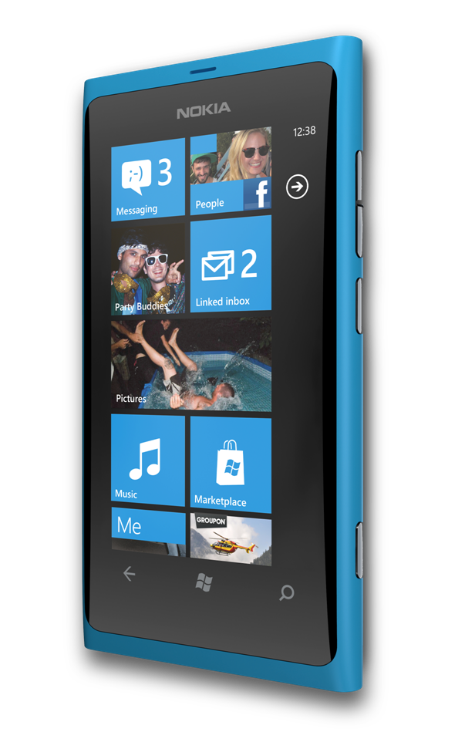
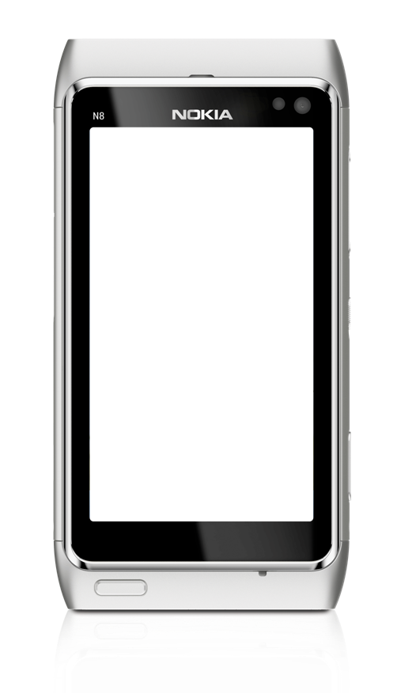
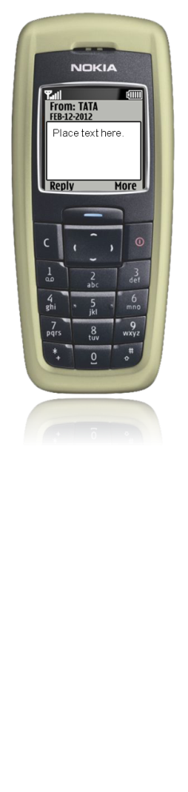
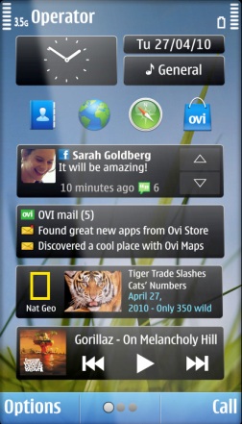
The ‘Where Aware’ Sensor Evolution
AND …
NFC, SPEED, VIBRATION,
AMBIENT NOISE,
HEART RATE…
AND …
GPS, COMPASS, LIGHT SENSOR, ACCELEROMETER
MICROPHONE,
CELL ID
© 2012 Nokia
Notes:
The days of someone owning a single internet connected device are almost over. We’re now buying, owning and using multiple mobile devices. At the same time, these devices are getting smarter – firstly, because they are increasingly connected to the cloud and secondly because they are sensor-rich.
(click)
From NFC for payment in stores and on transport, to more advanced sensors that interpret if you’re running versus taking a bus, all the way to sensors that connect with devices like wrist band heart rate monitors – these sensor-rich devices provide us with critical data that helps us better understand location related behavior which in turn helps us to identify patterns and trends.
(click)
To build the Where Platform, we believe you need four essential components … data, a platform that uses this data, APIs that expose the platform and apps and experiences that showcase the power of the platform and its data.

Slide 5













The Most Realistic View Of The Real World
196 countries
75M Places
27 cities in 3D
2.4M map
changes/day
500+ public
transport cities
120M point
addresses
26 countries
with Traffic
12K 3D landmarks
© 2012 Nokia
Notes:
So first, there’s data; we have a lot of data, from best-in-class, navigation quality, mapping assets through to global, yet local, location based data.

Slide 6
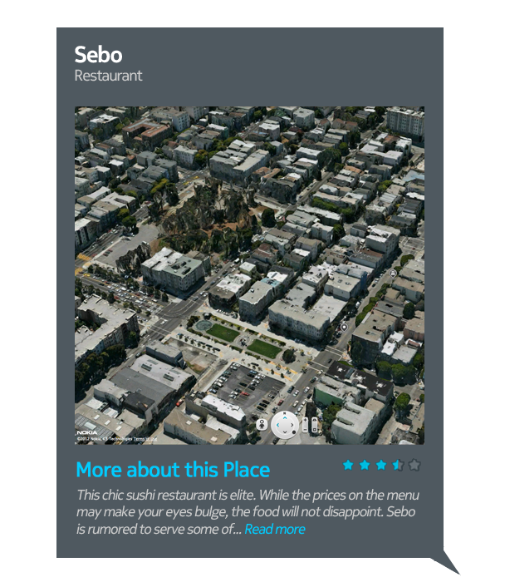
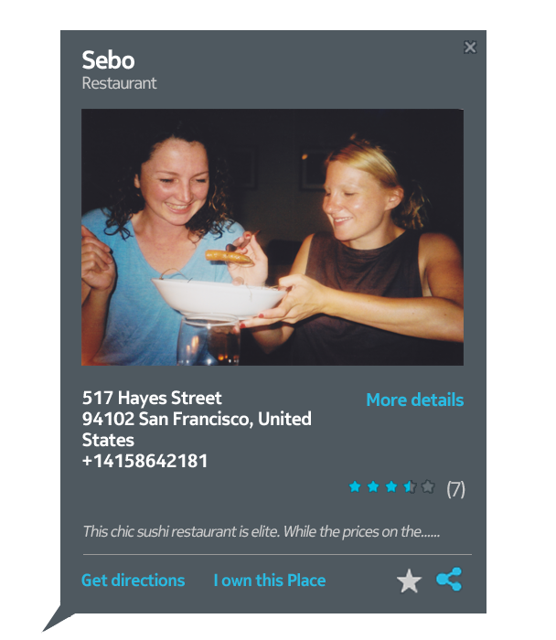
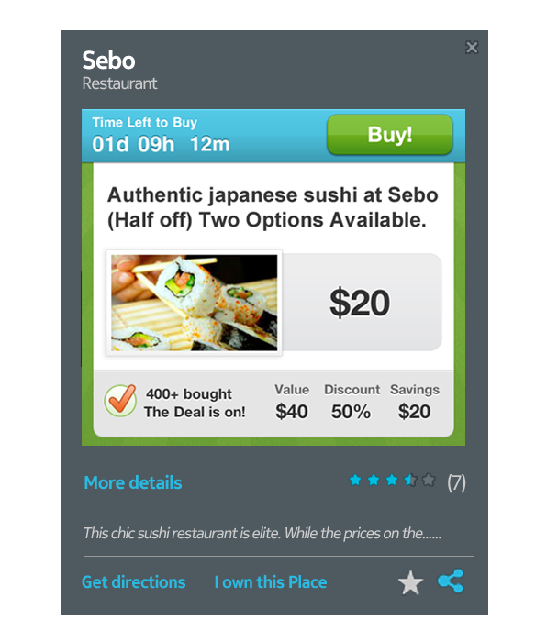



A Learning Engine; The Where Platform
Reference Data
Activity Data
Smart Data
© 2012 Nokia
Notes:
The Where Platform is built on top of this data and what’s more, it learns from the data. We call this a learning engine and it’s because there’s really two sorts of data out there … reference data and activity data.
Let’s start with a Place. Where and what is this Place? This is reference data, the index of world around us and it enables the routine location functions we take for granted, such as search, routing and navigation.
(click)
Then there’s activity data that utilizes the types of sensors I just spoke about (click) to understand how people interact with their devices, their apps and the real world around them.
(click)
Or to put it another way, we know about a Place and we can know what actually happens, in the real world, at this Place. Put these two types of data together and it becomes what we call smart data and it’s this that powers the Where Platform and enable us to create a digital, predictive model from all the Places and objects in the physical world, including our user’s needs and activities.

Slide 7

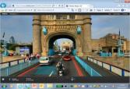

















Powering Solutions Across Screens
The Where Platform
Smart Data
© 2012 Nokia
Notes:
The reference and activity data I mentioned earlier, combined as smart data, powers the Where Platform. The platform in turn powers the showcase for this, our apps, which I’ll cover in a few slides time. But apps aren’t enough in today’s world, you need robust APIs as well.
There is a unique opportunity to work with you and with developers to build the where-enabled ecosystem; across verticals and across the screens we use on a daily basis, to power the experiences you’re building for your users.
So let’s dig a bit deeper into the APIs …

Slide 8
A Portfolio Of Functional APIs
Nokia Maps API
for JavaScript
Nokia Maps API for JavaScript
Nokia Places API for JavaScript
Nokia Places API for HTTP
Nokia Maps API for HTML5*
Nokia Map Image API for HTTP
Web
Nokia Maps API
for HTML5*
Mobile Web
Nokia Maps API for Qt
Nokia Places API for Java ME
Nokia Maps API for Windows Phone*
Native Mobile
* coming in 2012
© 2012 Nokia
Notes:
We already have a set of modular, configurable, highly performant APIs that are easy to use and to integrate, with an active developer community who appreciate our simple and fair terms of use. For the web, we have JavaScript APIs for Maps and for Places as well as a new Places web service API, more of which in a few moments. (click) We’re going to be unifying the JavaScript APIs for Maps and for Places into single API under the Nokia Maps for JavaScript API banner. (click) There’s also our Map Image web service API and our upcoming Maps API for HTML5, which I’ll talk more about in a few slide’s time.
(click)
And for native mobile use, there’s out Maps API for Qt and our Places API for JavaME and coming later this year our Maps API for Windows Phone.

Slide 9

















A Commitment; For All Screens
© 2012 Nokia
Notes:
APIs are of course utterly critical to the Where platform and the Where ecosystem but we also to ensure that we cover all the screens that act as touch-point between the digital and real words for people throughout their day. As I move from my computer at work, to my laptop, to my in-car nav system, to my tablet, our goal is to have an offering for virtually any of these screens.
In addition to the Places API, I also touched on APIs for Qt, for Windows Phone and for JavaME for Nokia devices. For non-Nokia handsets and platforms, you can already see the power of the NLP on maps.nokia.com on the web and coming soon will be native HTML5 support. (click)
You may already know of the Nokia Maps app for Windows Phone, but Nokia Maps is already available via the Amazon Android Store and includes routing for drive, walk and public transport.
We’re also announcing a closed beta of our Nokia Maps HTML5 API, which is the first of many huge milestones we hope to achieve to expand our APIs and presence across screens as quickly as possible.

Slide 10

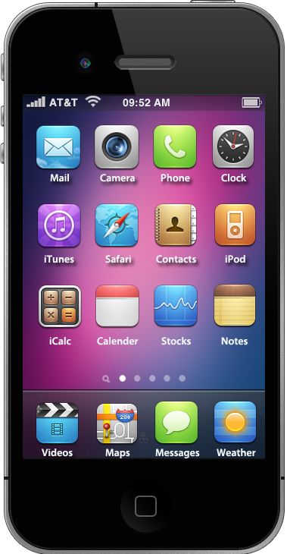
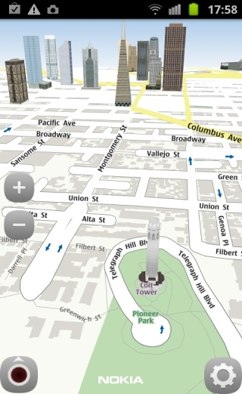
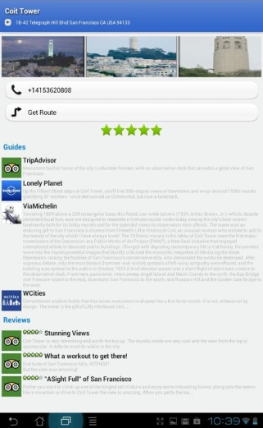
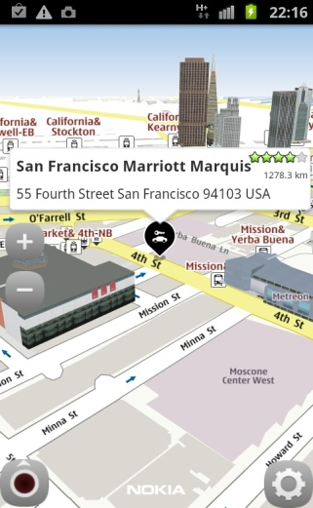
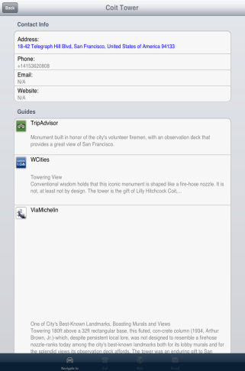
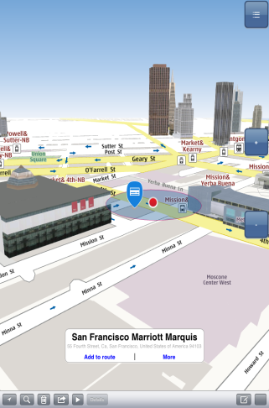
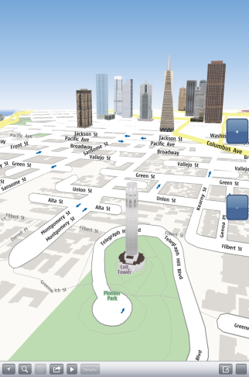


A Commitment To Grow The Ecosystem; Non-Native And Native APIs
© 2012 Nokia
Notes:
I mentioned a few slides back that we’re making a commitment to support the Where Platform across all screens, by making the platform device agnostic and truly horizontal. (click) You may recognise the mobile devices behind me and, although these are screenshots of our maps on both Android and iOS, these are not mocks-ups, they’re from real proof of concepts, using the Where Platform. But these are not apps that we’re releasing so don’t rush to your mobiles to try and download them. But if you want to see them live, in action and in person, you’ll be able to see and play with them at the Nokia booth.

Slide 11


The Places API; Over 75 Million Places
Restaurants
See you there…
© 2012 Nokia
Notes:
Now, a few slides back I mentioned our Places web service API. This is in addition to our Places API for JavaScript and so I’m really pleased, or as we say in Britain, chuffed, to announce the public beta of this …
Through our Places API you can:
Discover Places by searching explicitly and nearby (click)
Display Place information, basic and extended data attributes, rich content, editorial and user generated content; this is far more than the offerings of some of our competitors
(click) Interact with a Place, share it, (click) navigate to it
Through the Nokia Places API, you can find locations in more than 1.5 million areas (cities, districts, and regions) as well as more than 120 million point addresses across 15 countries.

Slide 12

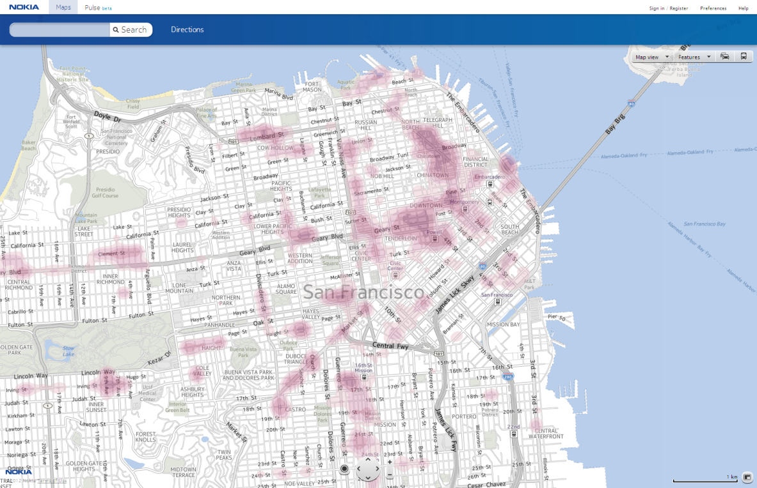
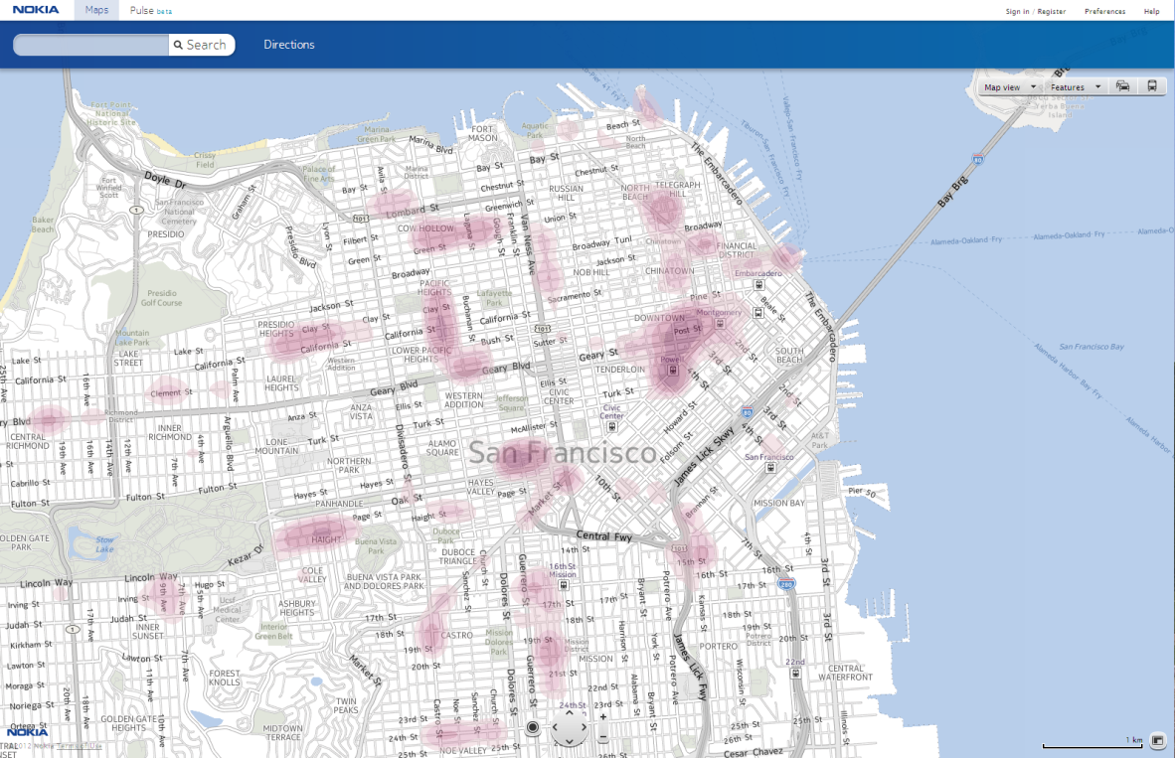

Enabling More Informed Decisions
Where should we go to… eat?
Where should we go to… shop?
© 2012 Nokia
Notes:
The term Places API is usually synonymous with searching for Place information and with displaying a page containing this information, but there’s far more to Places that just this. Look at these heat maps behind me; they’re great examples of the type of experience you can create using the Nokia Places API. These dynamic heat maps are produced by combining Place categories and other algorithmic inputs to show were you might want to eat (click) or shop. This is great for getting a feel for a locality that you may be unfamiliar with.
We know that a powerful set of API offerings is critical to our ability to recruit partners to help build the Where ecosystem. This is why I’m excited to share the launch of the Nokia Places API web service with you today.

Slide 13







Powering Competitive, Global Solutions
© 2012 Nokia
Notes:
At Nokia, we realize that becoming the Where company is not an easy task. The Platform alone is not enough, nor is produced a set of APIs enough. There needs to be support, documentation and tools which work the way you work. But we also know that sometimes you just want to join in the fun. And so, over the past year we have been working hard to grow the Where ecosystem.
We’ve added customers such as those listed here and these have increased the hits to the platform from 560M/month in Q1 2011 to 4.6B/month in Q1 of this year; that’s around a 750% increase.

Slide 14


Serving millions of Yahoo users worldwide
1200 queries per second
99.9% availability performance
© 2012 Nokia
Notes:
For example, we have been working with Yahoo! since late 2010. All Yahoo! sites that have a map element will be served by one of Nokia’s Location & Commerce data center locations around the world.

Slide 15
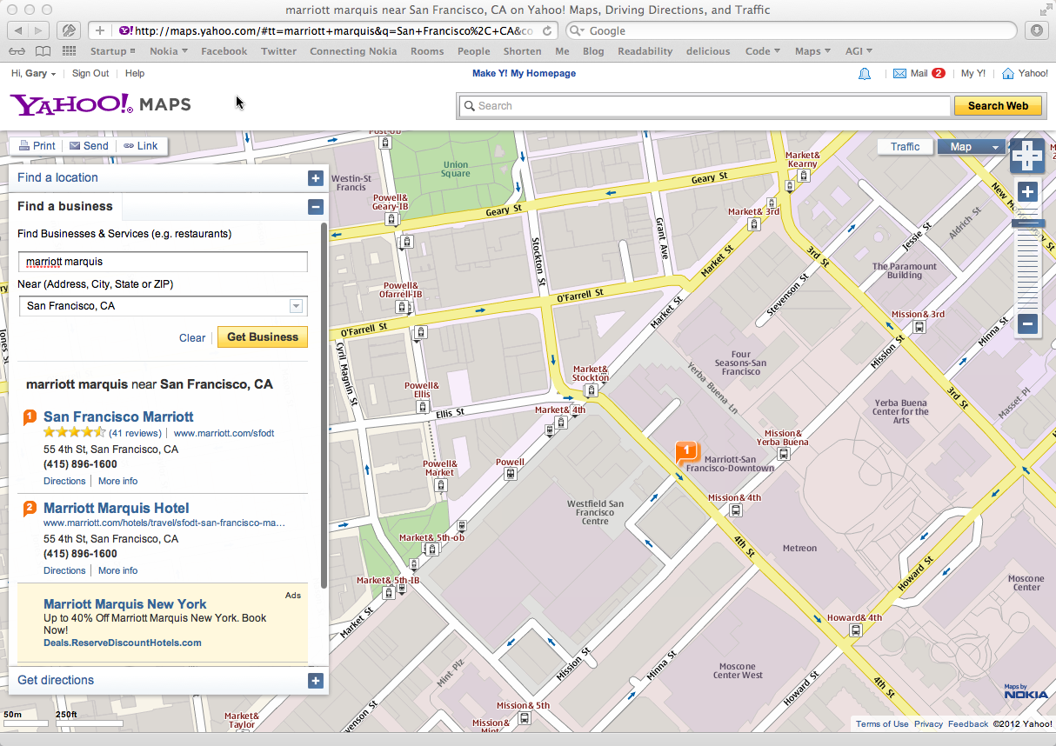
© 2012 Nokia
Notes:
Whenever one of millions of Yahoo! users checks out a location, Yahoo! sources its mapping/imagery, routing, traffic, and geocoding services from the Where Platform.
Dirk Daumann (Nokia Head of Map Services Platform): “We have served millions of Yahoo! users worldwide for around 150 days. Our service has been available to 99.9 per cent. This means that we have constantly exceeded what was agreed, something that we are very proud of. During peaks, we serve 1200 queries per second, a number that we estimate to grow when the transition of all Yahoo! sites to our services has been completed.”

Slide 16

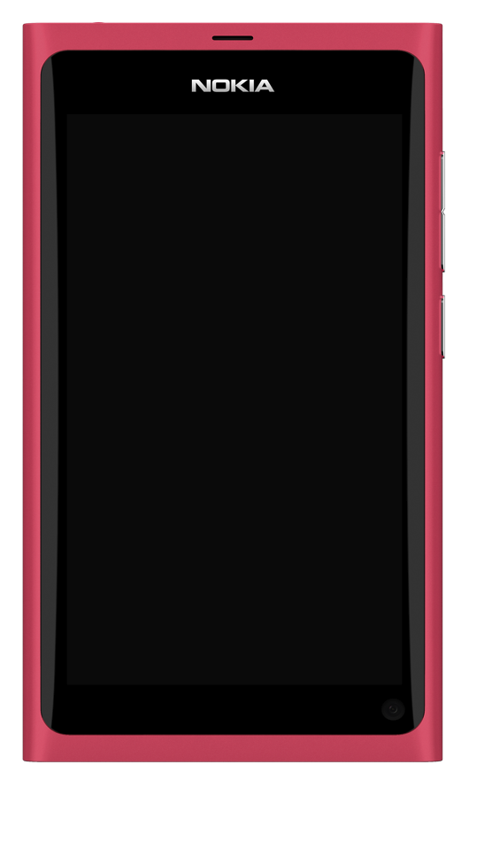
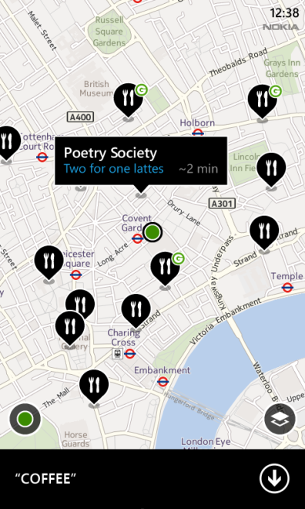
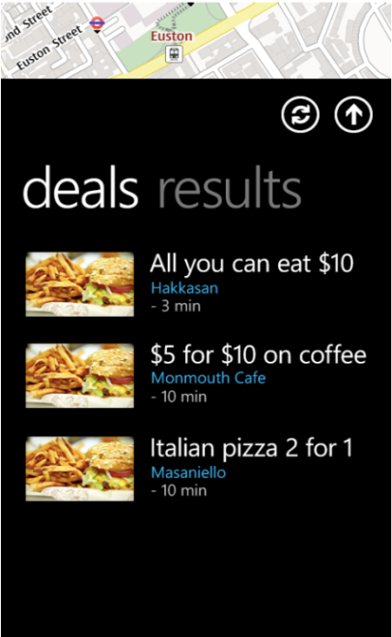


Together, making deals location-relevant
© 2012 Nokia
Notes:
Additionally, we recently announced our partnership with Groupon to collaborate on a redesign of the customer experience of deal discovery, purchase and redemption.
We plan to do this by working with them to offer market-leading, location-sensitive discounts and deals that are more locally relevant and convenient. By the way, as we’re early in our relationship with Groupon, the graphics you can see behind me are a mock-up, not a real app, so no heading to the Marketplace to download please.

Slide 17
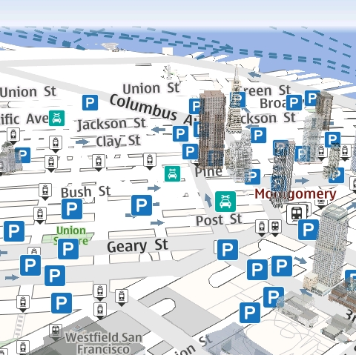
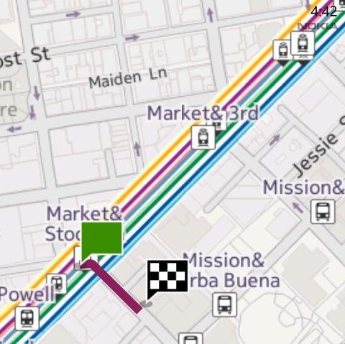
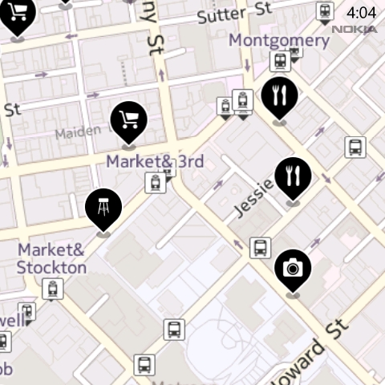
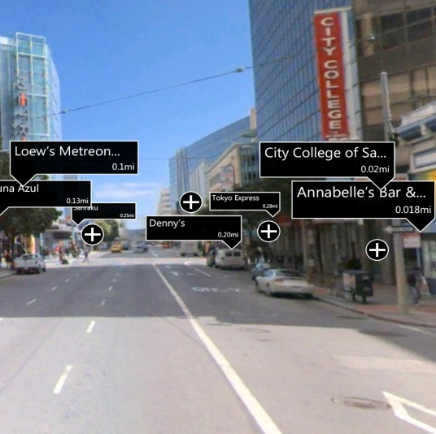
Where Platform Implementations
Nokia Drive
Nokia Transport
Nokia Maps
Nokia City Lens
Nokia Pulse
© 2012 Nokia
Notes:
What I’ve just been talking to you about over the last 15 minutes or so, shows, I hope, the massive amount of investment and commitment we’ve made over the past year to building a where-enabled ecosystem and in achieving our goal of becoming the Where company.
Similar to our Platform and APIs, we’ve met major milestones with our apps as well. Today, we have 5 apps that are based upon and showcase the Where Platform (click):
Nokia Drive provides free, in car navigation for driving and reaching destinations safely.
Nokia Transport allows you to have all your commuter information at your fingertips: No more carrying around city maps or timetables—it is all on your device, wherever you are.
Nokia Maps provides new ways to discover and explore the world around you. (click)
Nokia City Lens augmented reality browser turns a phone’s camera viewfinder into a new way to spot nearby attractions, shops, restaurants and places of interest.
Nokia Pulse is an exciting new way to privately check in, meet up and stay in touch with the people, like family and close friends—with just one click.
In fact, these apps are one of the best ways to illustrate the power of the Where Platform. What we’ve done with our apps is just the beginning. And with the power of the platform and our APIs, the opportunities for you to build unique, location-relevant solutions are endless.

Slide 18
Want To Know More? developer.nokia.com/maps
Booth #208
© 2012 Nokia
Notes:
We see an opportunity to work with you to build a where-enabled ecosystem. For all of us to become part of something bigger.
To be part of an ecosystem that stretches across screens.
That spans B2C, B2B and B2D.
That answers consumer’s where-related questions and empowers them to explore and enjoy the increasingly merged physical and digital world around them.
If you’re interested in discussing further how we can work together, please swing by the Nokia booth – it’s number 208.

Slide 19
Thank You!
Gary Gale
Director, Places
Nokia Search & Places
+49.1515.5150909
+1.408.242.2329
+44.7508.000336
gary.gale@nokia.com
© 2012 Nokia
Notes:
… thank you for listening

